Slide 1
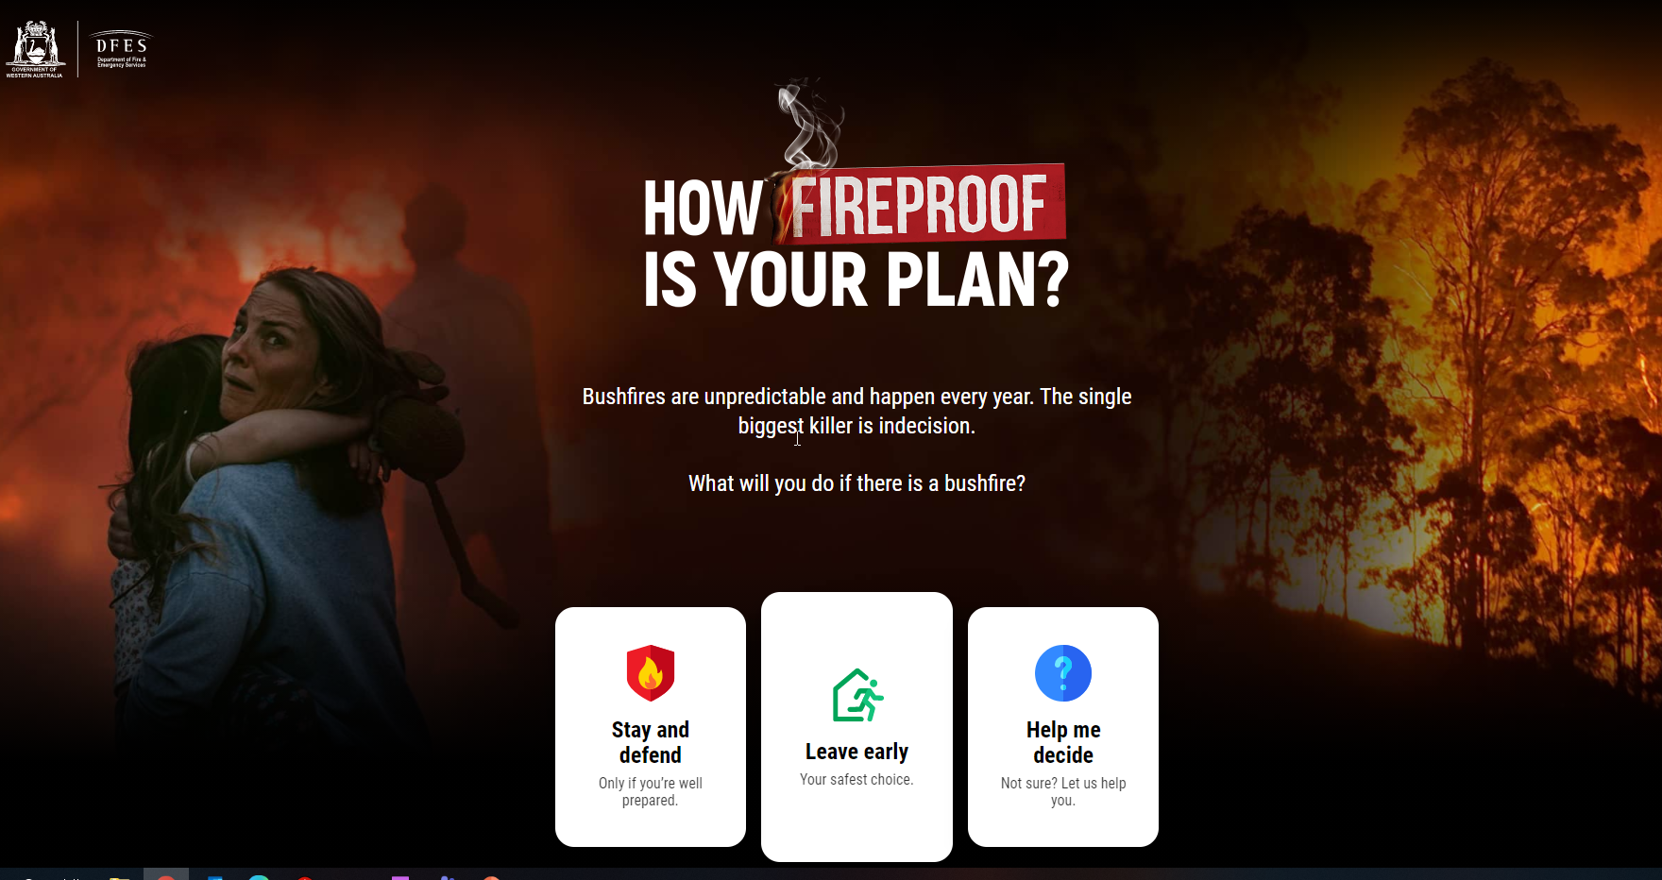
Safety Moment
https://mybushfireplan.wa.gov.au/

Slide 2
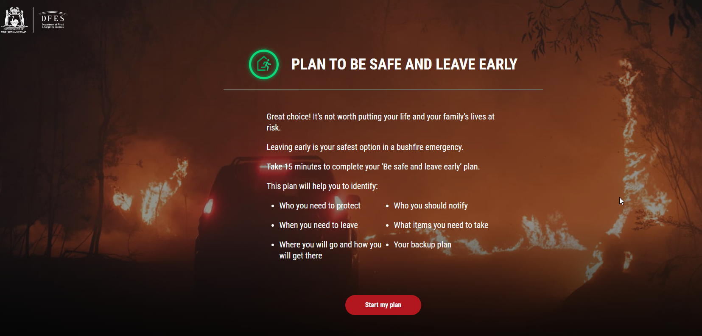
Safety Moment
https://mybushfireplan.wa.gov.au/

